Slide 1
6D Object Pose Estimation
TA: 王炜清

Slide 2
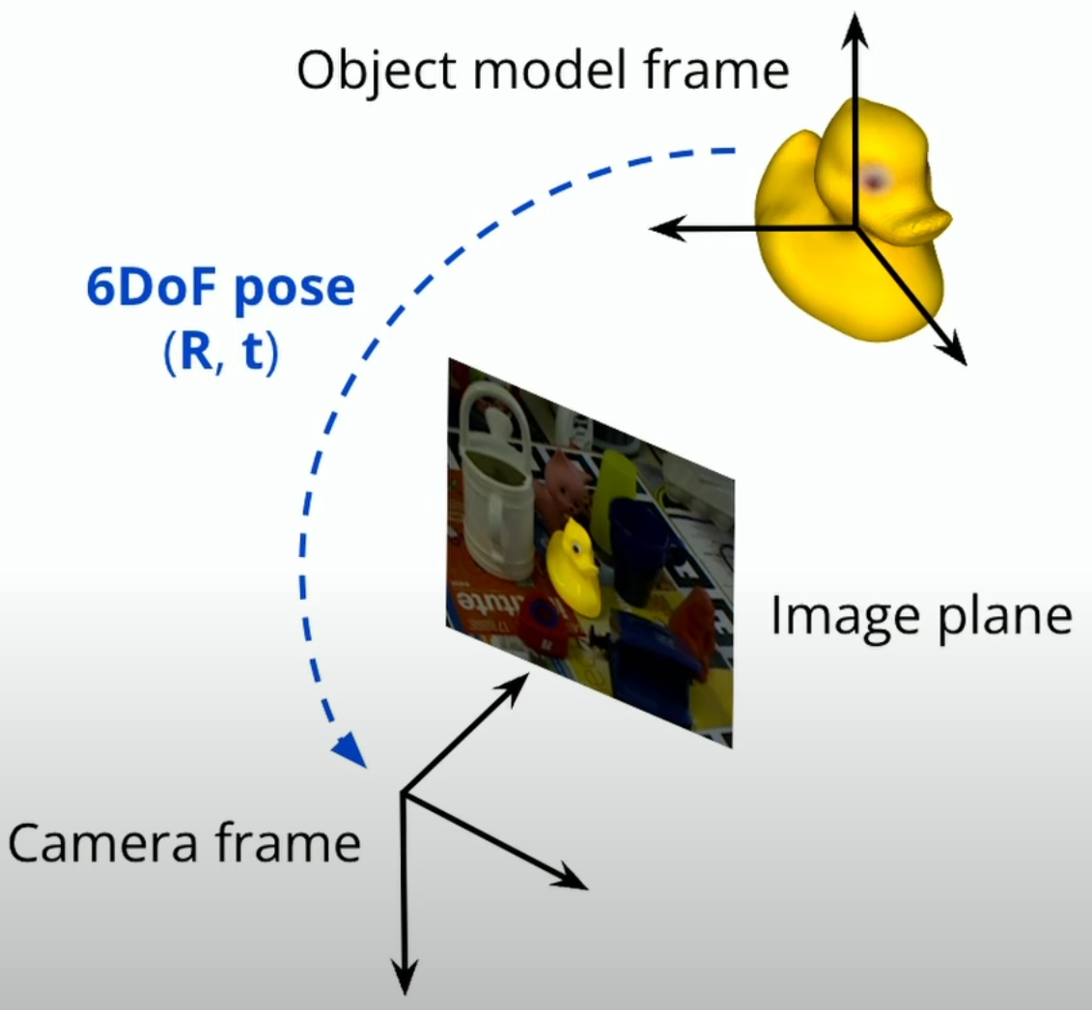
6D Object Pose
6 degree of freedom
Translation + Rotation

Slide 3
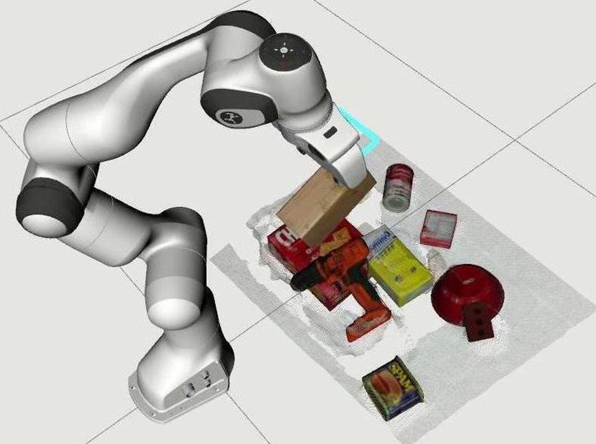
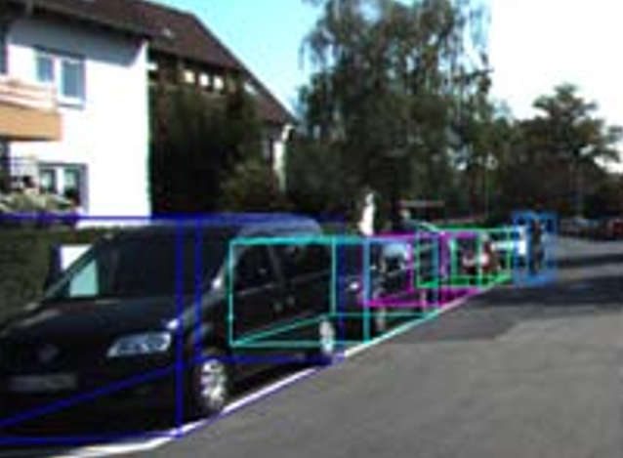
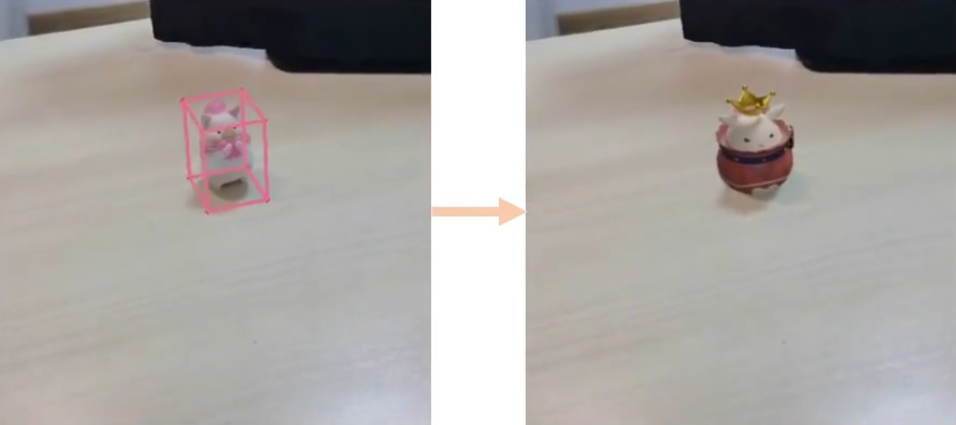
Application
Robotic Manipulation
[CVPR 2020] MoreFusion
Autonomous Driving
[CVPR 2020] KITTI
Augmented Reality
[ECCV 2022] Gen6D

Slide 4
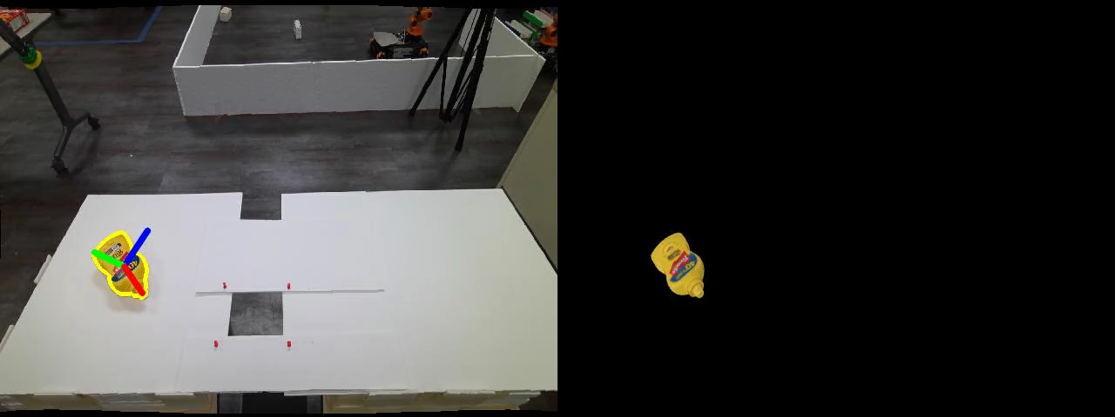
Robotic Applications
[CVPR 2024] FoundationPose: Unified 6D Pose Estimation and Tracking of Novel Objects

Slide 5
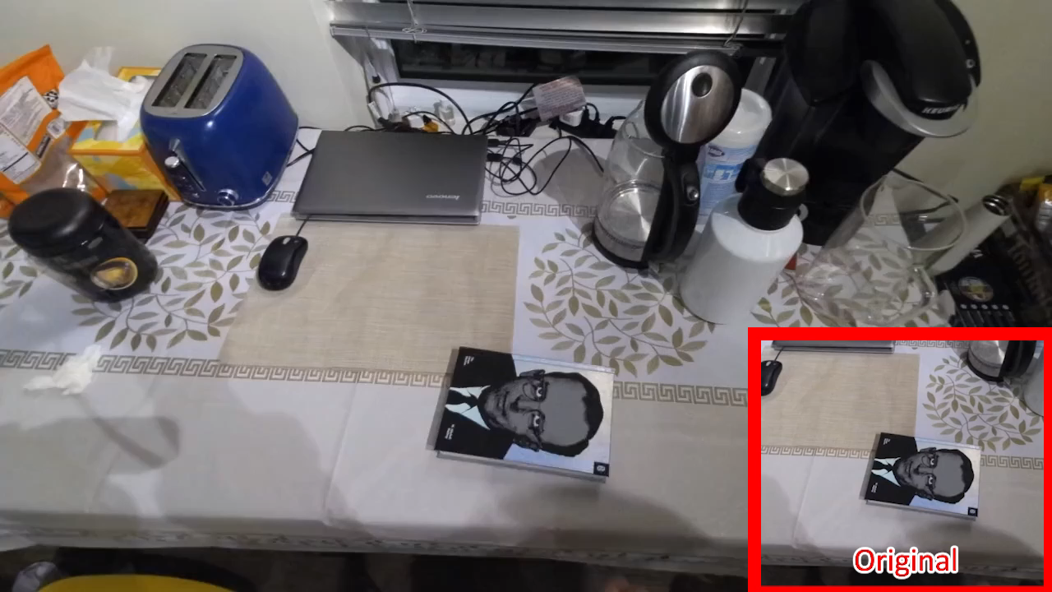
AR Applications
[CVPR 2024] FoundationPose: Unified 6D Pose Estimation and Tracking of Novel Objects

Slide 6
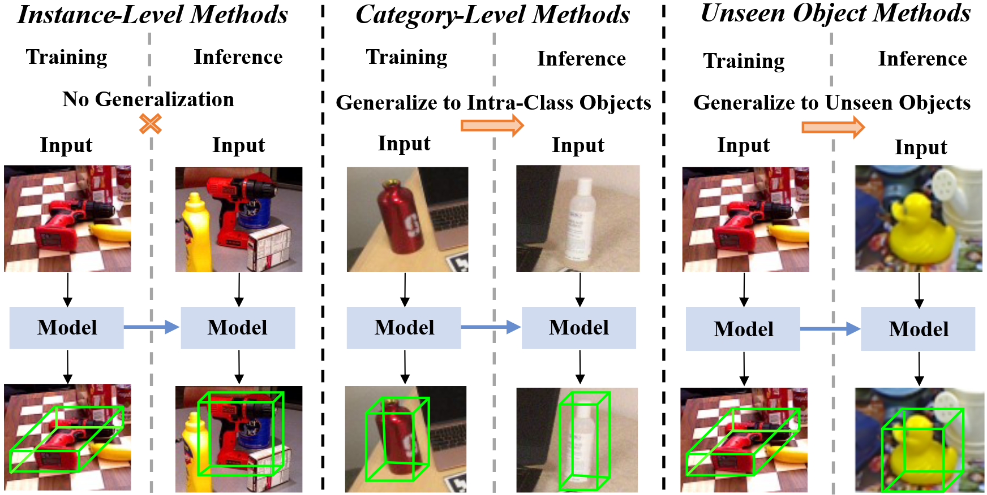
Three sub-directions

Slide 7
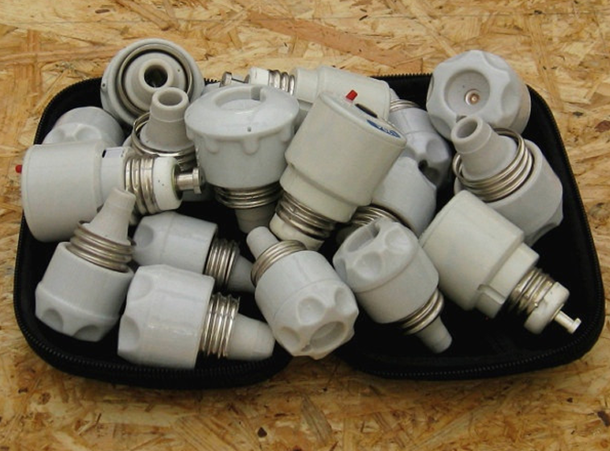
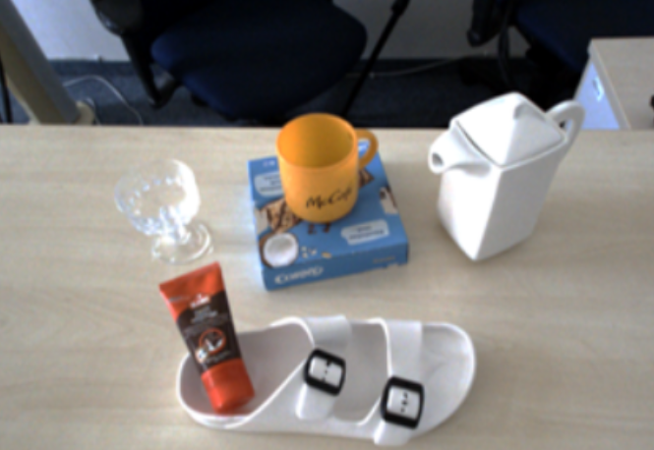
Challenge
Occlusion
Symmetry
Texture-less Object
Transparent Object
Limited Dataset
Representation of rotation
[WACV 2017] T-LESS
[CVPR 2024] HouseCat6D

Slide 8
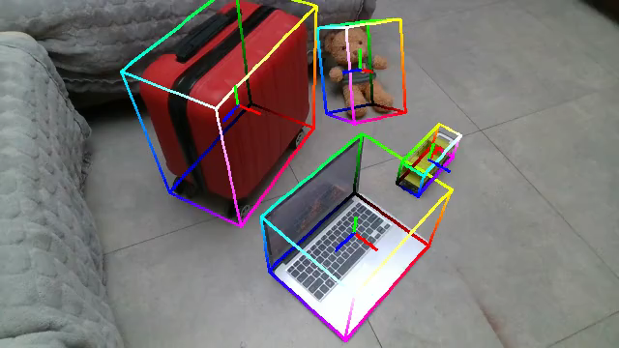
Omni6DPose
[ECCV 2024] Omni6DPose: A Benchmark and Model for Universal 6D Object Pose Estimation and Tracking

Slide 9
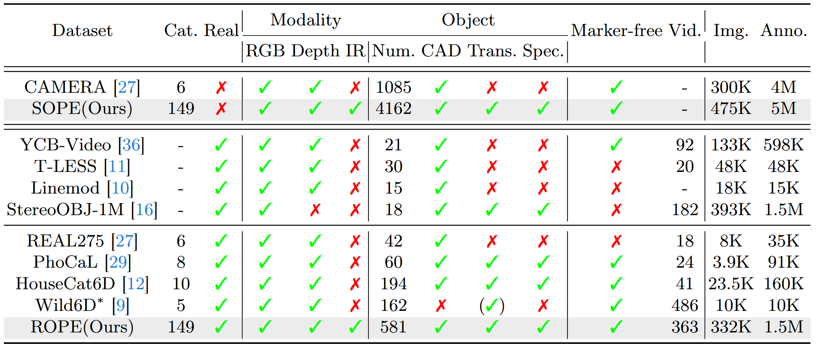
Related Datasets
[ECCV 2024] Omni6DPose: A Benchmark and Model for Universal 6D Object Pose Estimation and Tracking

Slide 10
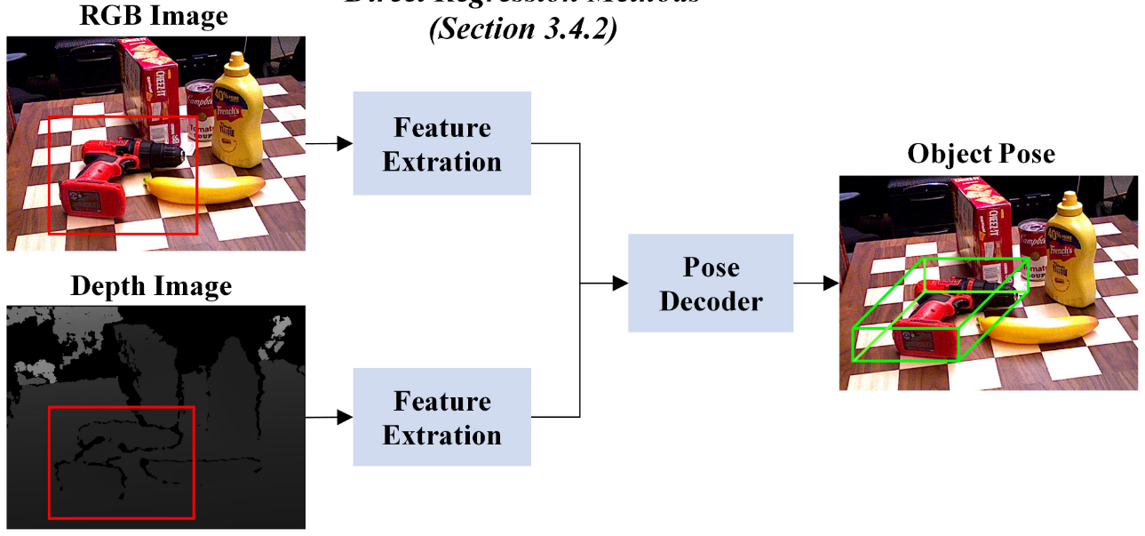
Direct Regression

Slide 11
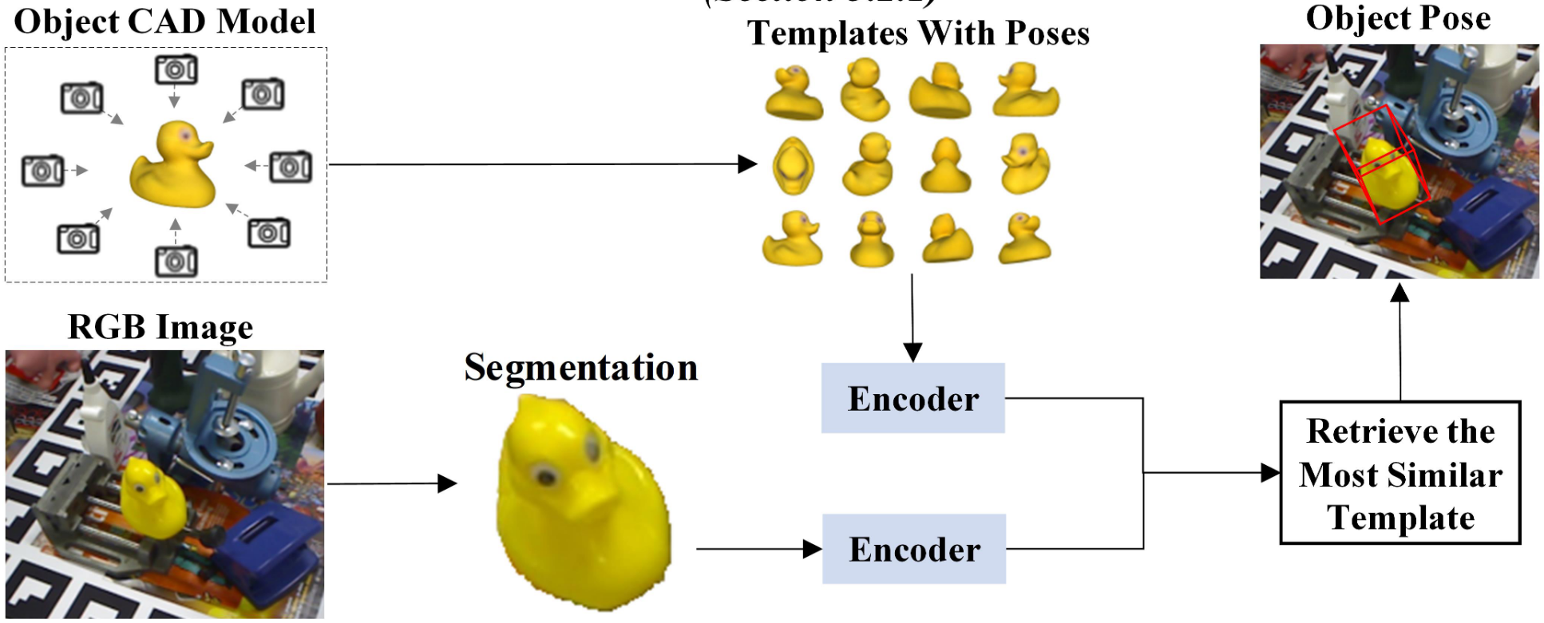
Render & Compare

Slide 12
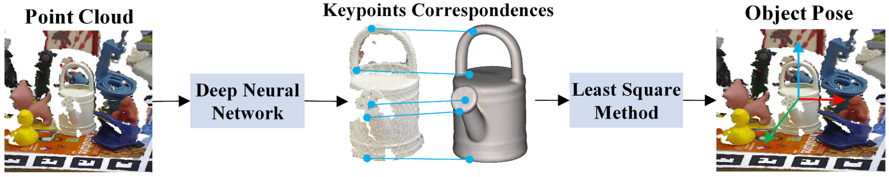
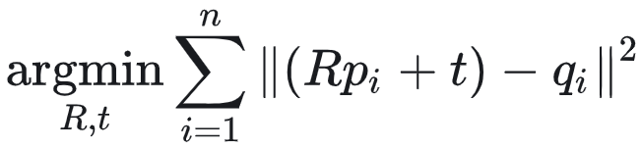
Correspondence-based Method

Slide 13
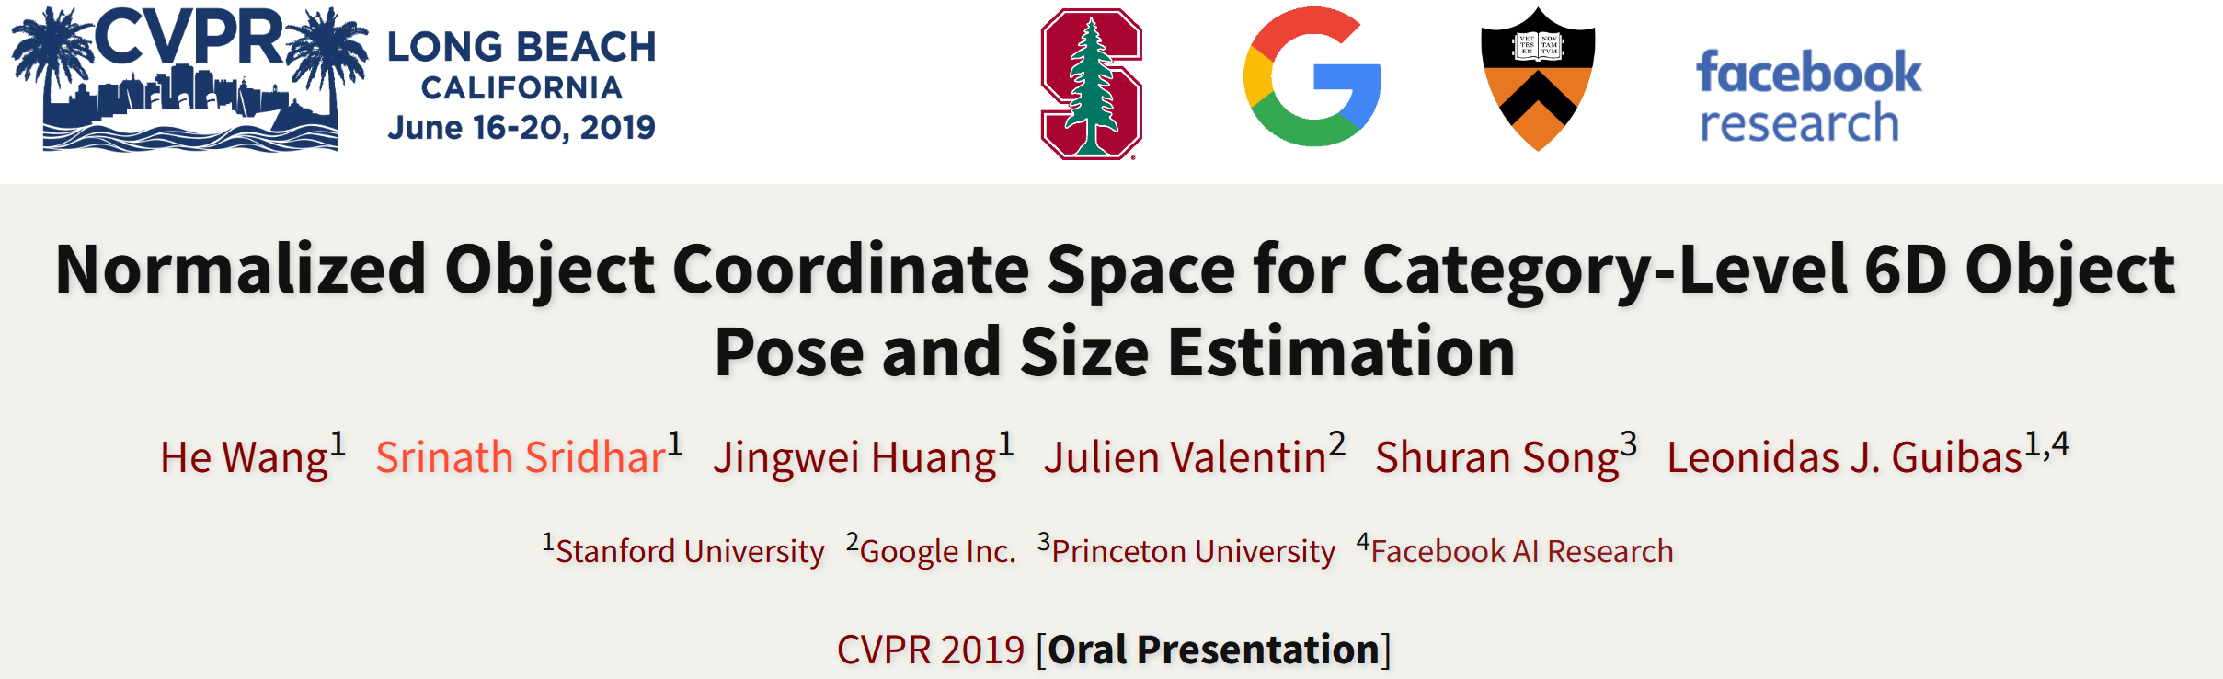
Representative Work 1
[CVPR 2019] Normalized Object Coordinate Space for Category-Level 6D Object Pose and Size Estimation

Slide 14
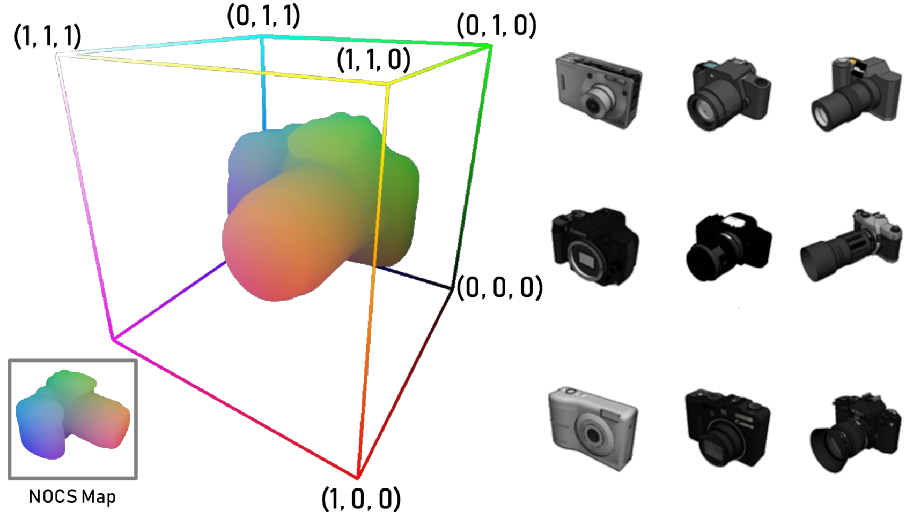
NOCS
Normalized Object Coordinate Space (NOCS)
[CVPR 2019] Normalized Object Coordinate Space for Category-Level 6D Object Pose and Size Estimation

Slide 15
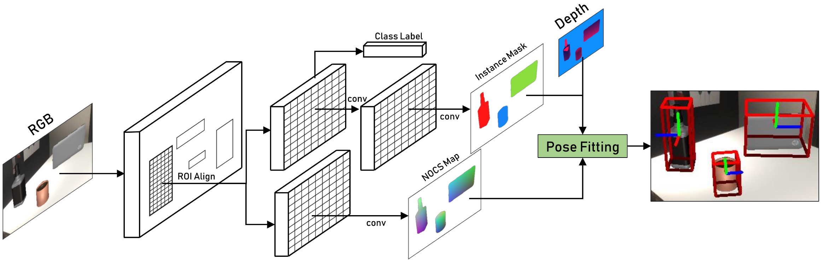
NOCS
[CVPR 2019] Normalized Object Coordinate Space for Category-Level 6D Object Pose and Size Estimation

Slide 16

Representative Work 2
[CVPR 2024] FoundationPose: Unified 6D Pose Estimation and Tracking of Novel Objects

Slide 17
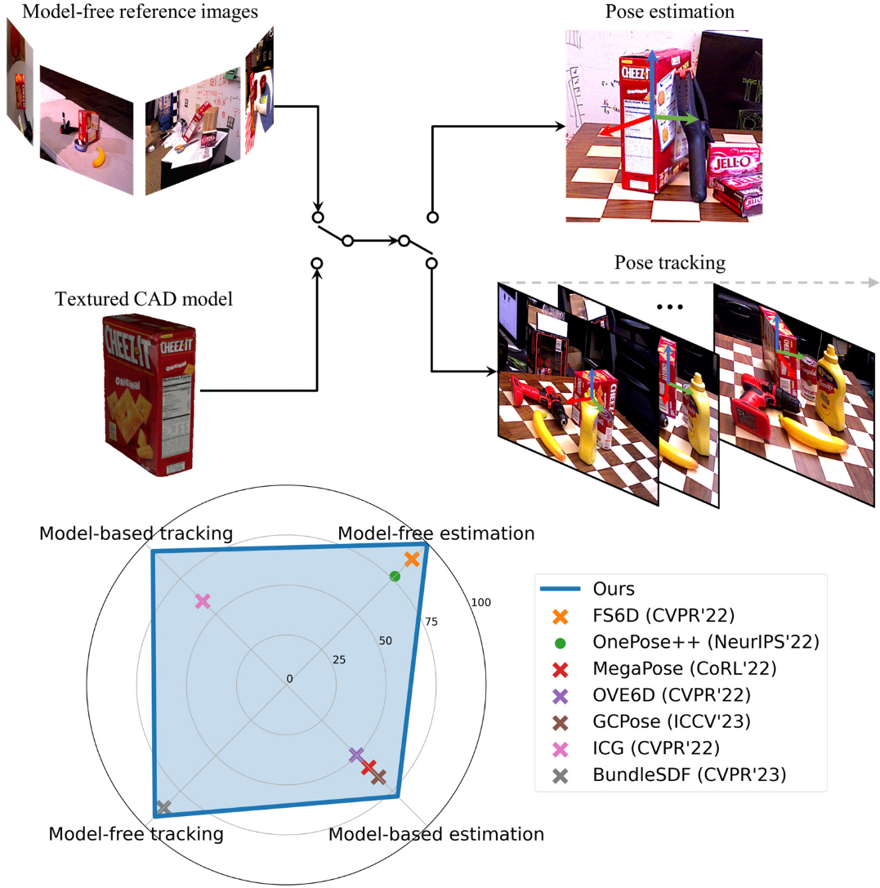
FoundationPose
[CVPR 2024] FoundationPose: Unified 6D Pose Estimation and Tracking of Novel Objects

Slide 18
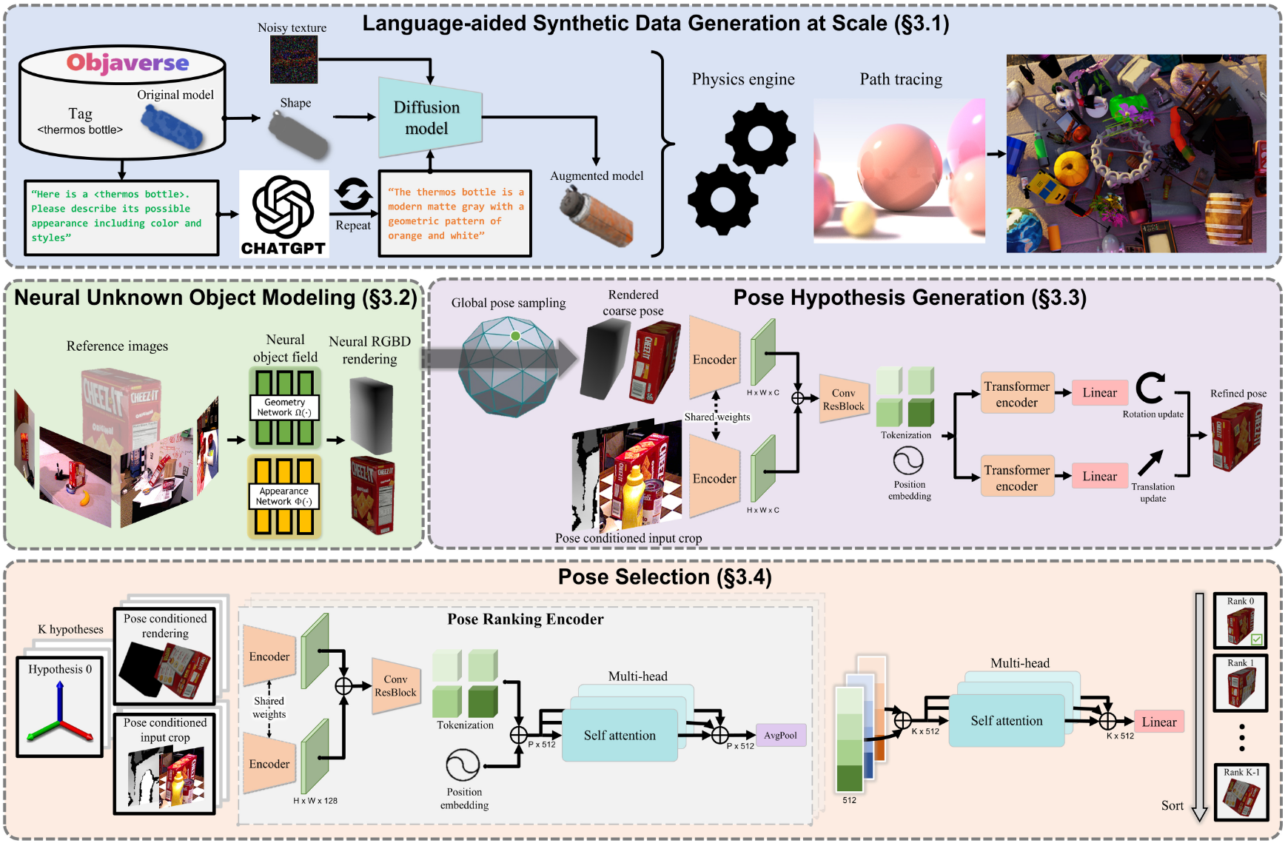
FoundationPose
[CVPR 2024] FoundationPose: Unified 6D Pose Estimation and Tracking of Novel Objects

Slide 19
Thanks!

